Slide 1
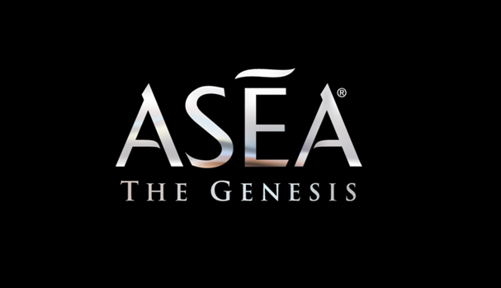

Slide 2

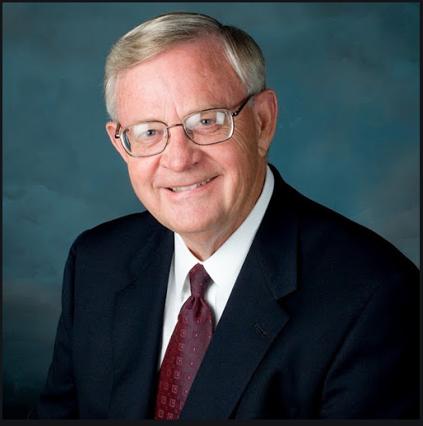
Verdis Norton

Slide 3
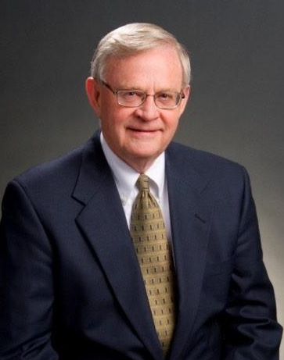
“ ¡No solo mi pensamiento se aclaró, tambien tengo mas energía y me siento mejor que todos estos últimos años! ”

Slide 4
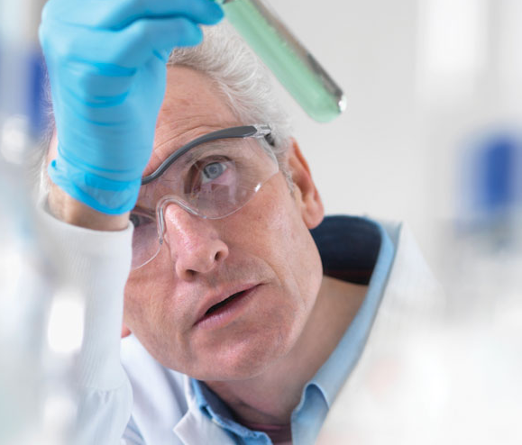

Slide 5

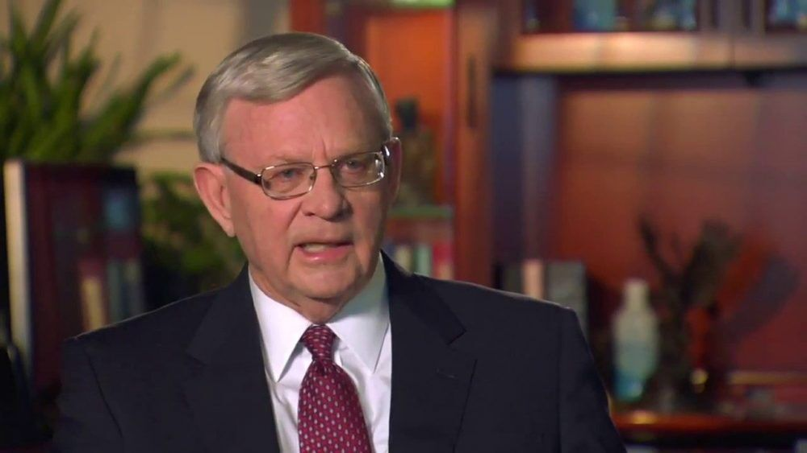

Slide 6
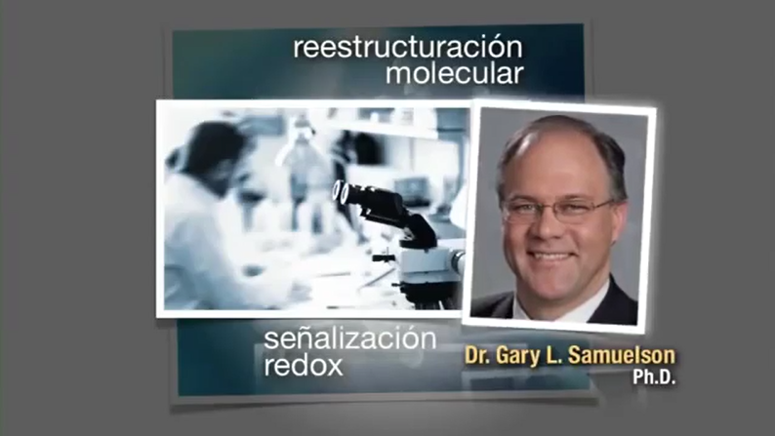
Notes:
Slide #30 They hired Dr. Gary Samuelson, an atomic medical physicist, who was eventually able to stabilize the molecules. The product was presented to a big pharma company, who did their due diligence and offered them a check "big enough they wouldn't want to talk to anyone else". However, they said they wanted to take it through FDA process and in order to do so, it could not be in the hands of the public, and they would have to cease production immediately.

Slide 7

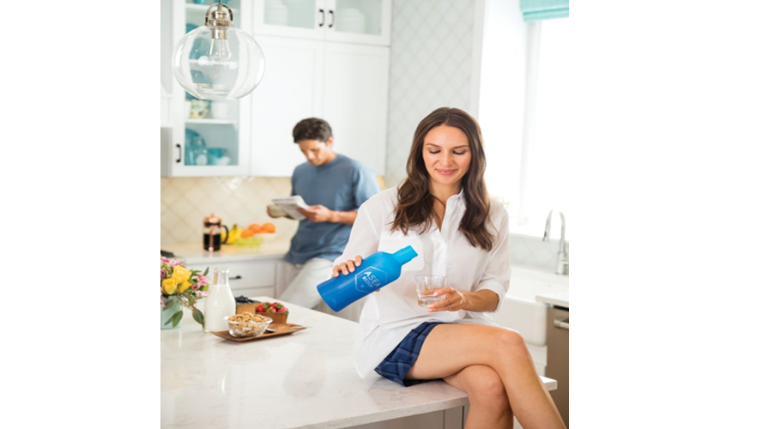

Slide 8


Slide 9

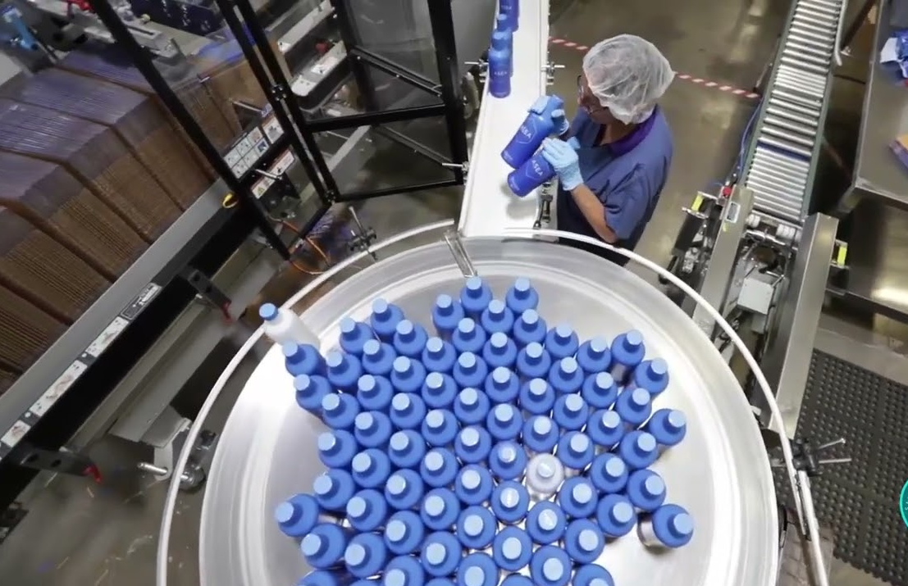

Slide 10
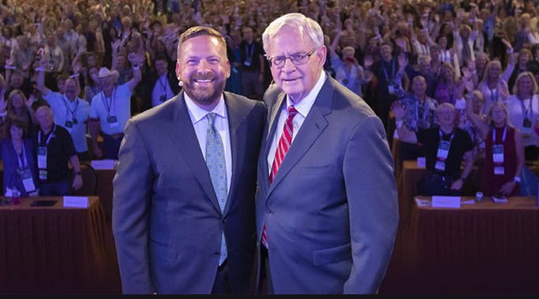

Slide 11
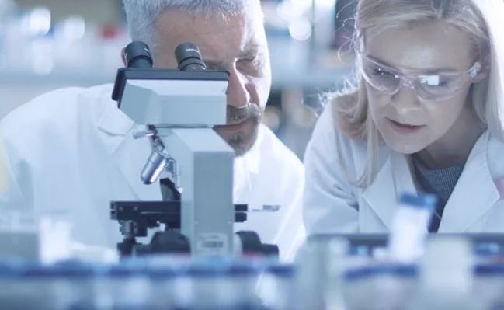


¿Que es esto?
LA CIENCIA DE ASEA

Slide 12

UNA EXTRAORDINARIA OPORTUNIDAD PARA TODO EL MUNDO
Notes:
Slide # 19 The fact that ASEA is a network marketing company is fantastic because it provides people like you and me to be able to share these transformational products with others and earn “thank you” money. We are all here with different interests so lets go over a few options.
You may just want to cover the cost of your product, or supplement your household income.

Slide 13

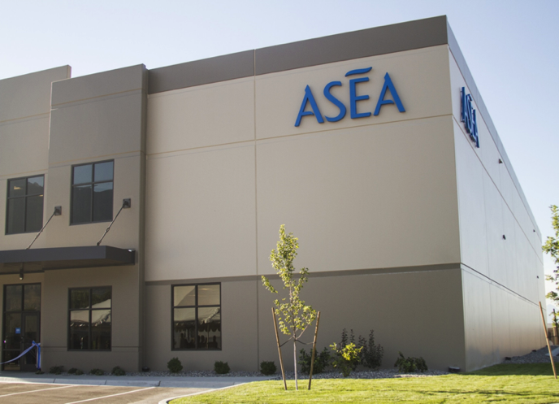
FINANCIERAMENTE FUERTE
Y ESTABLE
Con beneficios desde el años de apertura.
Sin deudas.
Infraestructura escalable – Capacidad de $800 millones
Los estándares más altos de calidad (FDA, GMP, NSF, Kosher…)
Notes:
Slide #7 …. After 9 months ASEA was completely debt free and in the first five years it grew organically into 26 countries, with people around the world using these products on a daily basis. Today we are shipping and doing business in over 32 countries and have the only production facility in SLC Utah.

Slide 14
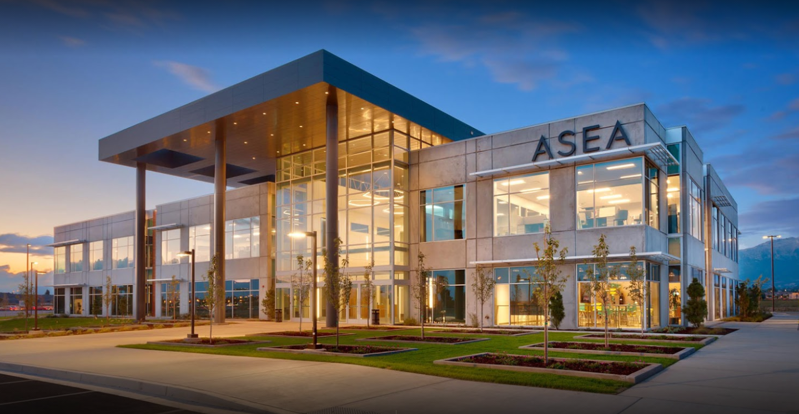

Slide 15
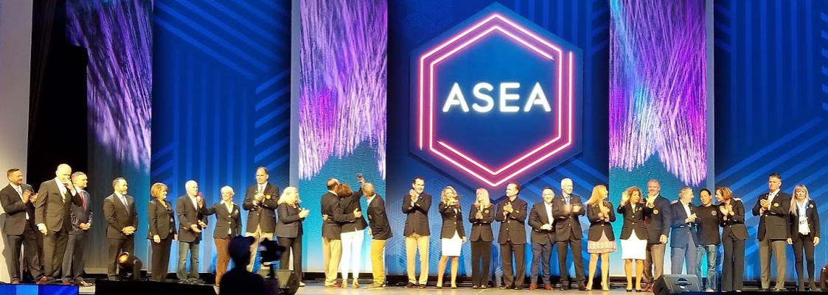


Slide 16
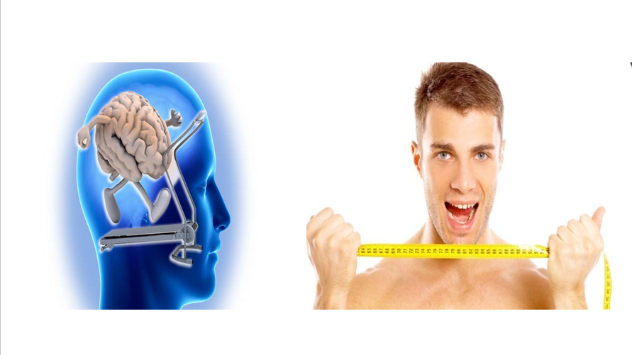
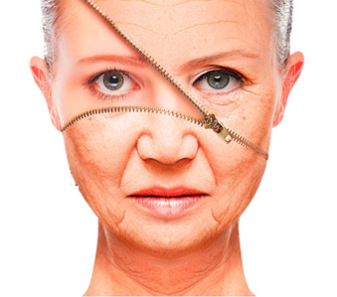

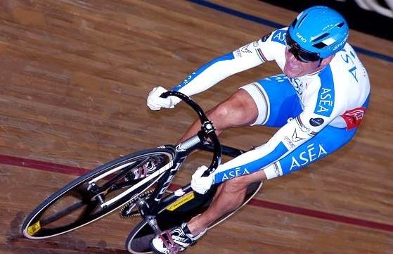


Slide 17
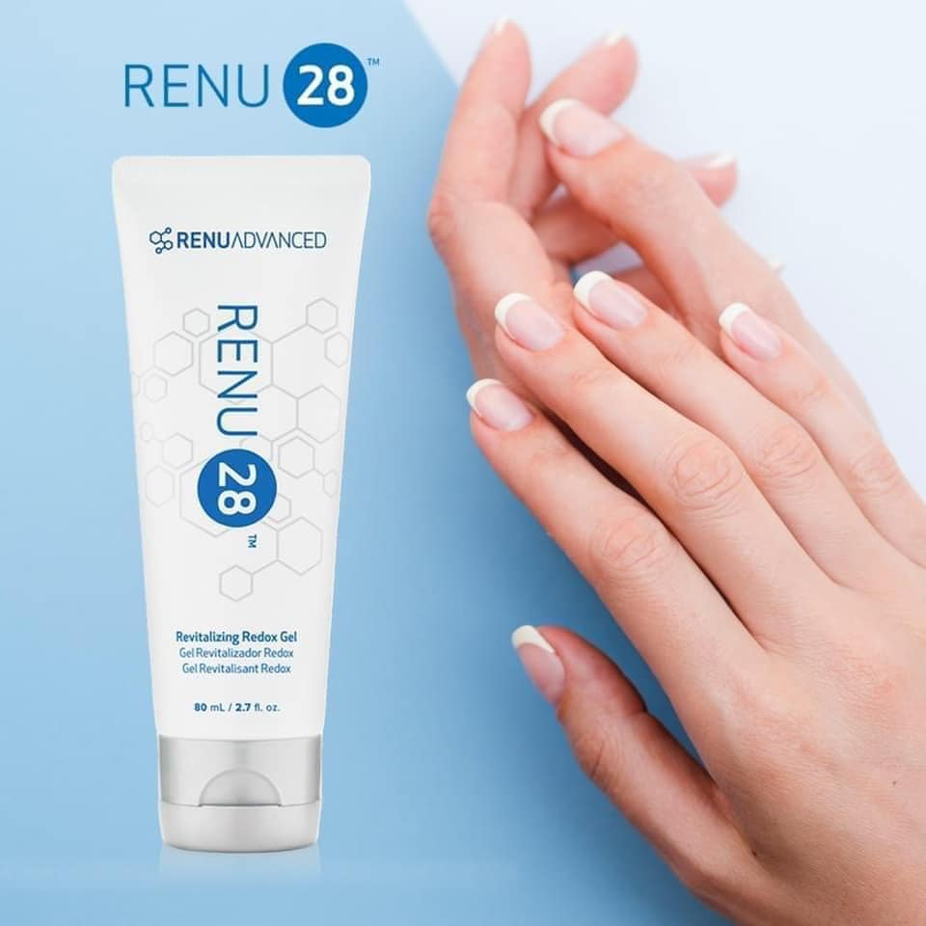
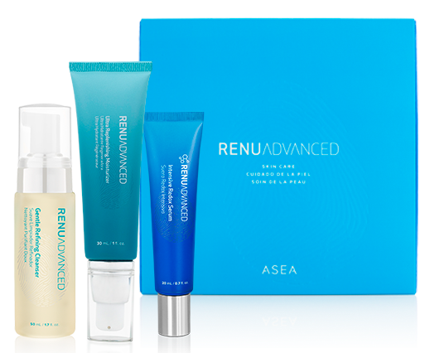
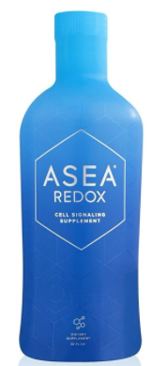
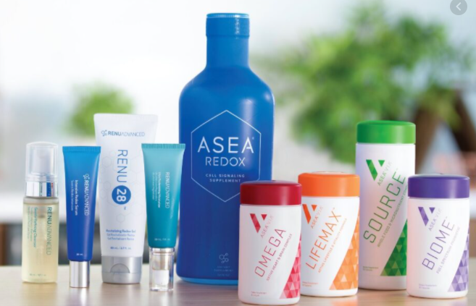
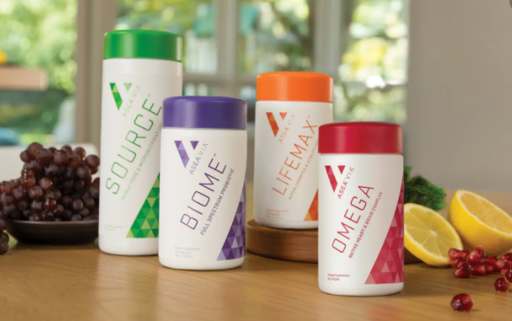

Slide 18



Slide 19
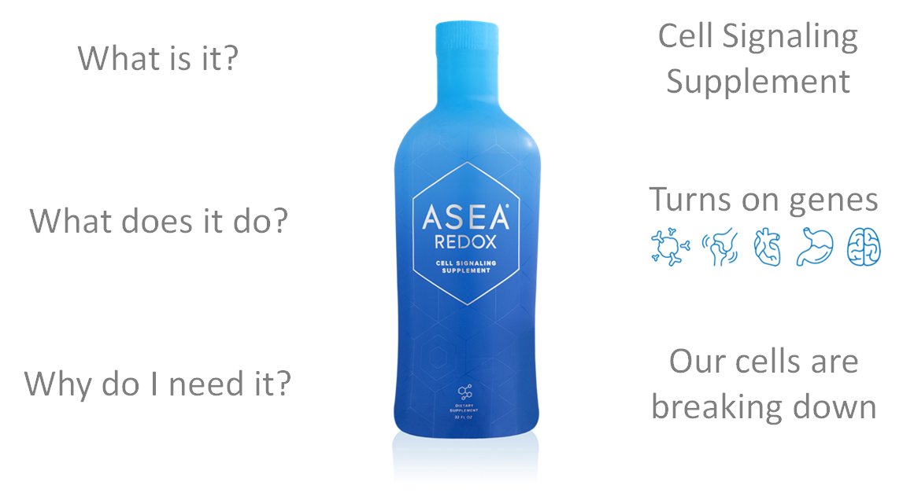
Suplemento de señalización celular
Regula la expresión genética saludable
Por que nuestras células están dañadas
¿Qué es esto?
¿Para que sirve?
¿Por qué lo necesito?
Notes:
Slide # 10 Wasn’t that video great in teaching us about our bodies and how they are designed to heal and repair?
So What is it? Cell Signaling Supplement.
What does it do? Turns on genes
Why do I need it? Our cells are breaking down every day.
Now that you understand more of the function of Redox Signaling Molecules let’s hear some real life experiences with this breakthrough technology.

Slide 20
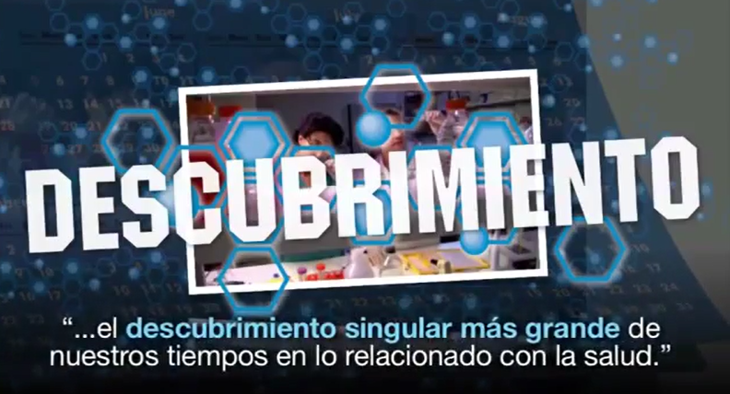
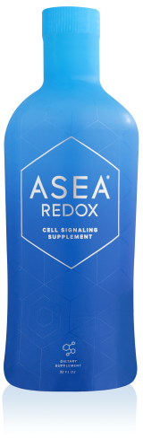
Notes:
Slide # 12 These molecules are considered NATIVE to the body, that means that the exact same thing that is in our bottle is in every cell of your body. It is impossible to be allergic to this product, and there is NO level of toxicity as well as no negative interaction with meds or other supplements. There is no LD50 for this product. LD50 means at what dosage does the product become lethal for 50% of the test subjects, (usually mice). When researchers tried to find an LD50 they finally said they'd have to drown the mice in it to cause harm as the more they gave them, the healthier they became! (by the way…. We do not have an LD50 result because the company did not want to have any harm to any animal in this study)

Slide 21
TESTIMONIOS

Slide 22
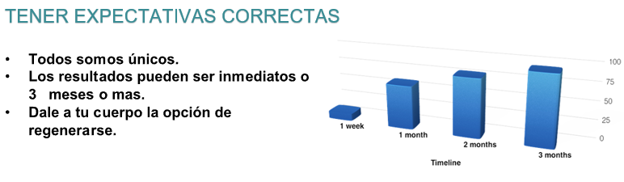
TENER EXPECTATIVAS CORRECTAS
Todos somos únicos.
Los resultados pueden ser inmediatos o 3 meses o más.
Dale a tu cuerpo la posibilidad de regenerarse.
Notes:
Slide #14 You do want to have reasonable expectations while taking ASEA. For many of us, it took a long time to get our bodies into the shape we are in...Its going to take a little time for tissues to heal and repair themselves.

Slide 23

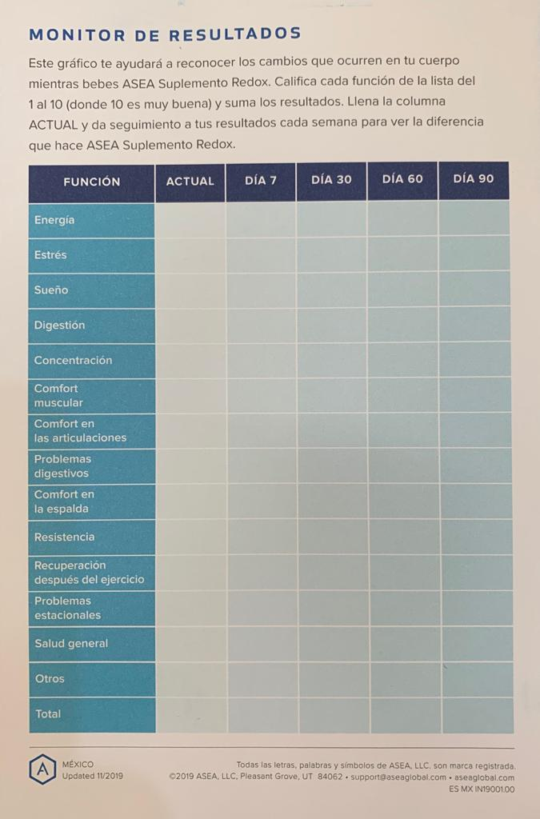
En algunos países ASEA incorpora inventario corporal en las cajas, pero tu mismo puedes crearlo:
Si inicias tu propio inventario corporal podrás hacer seguimiento de los cambios que ocurrirán en tu cuerpo a medida que tus células comienza a comunicarse mejor.
Notes:
Slide #15 With every case of ASEA comes a Results tracker form, it is very important to fill this out, you can customize it as well depending on your needs. When you take the redox molecules, you don't get to tell them where to go, your body has an inherent wisdom and will utilize them where IT sees fit. By taking inventory at the beginning, you will be more in tune to many of the subtle changes that occur as your cells begin to communicate more efficiently.

Slide 24
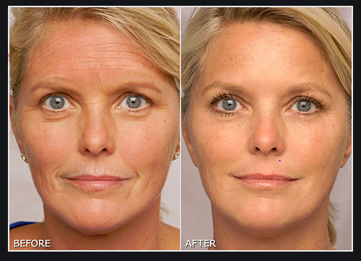
¿Como te gustaría lucir, sentirte, verte?

Slide 25
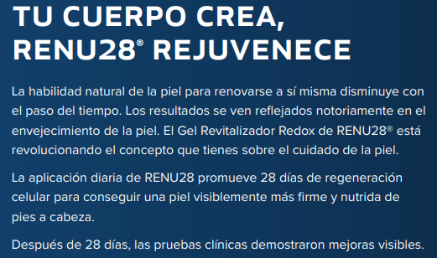
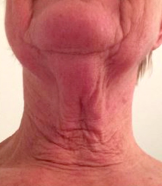
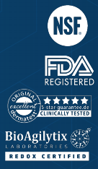
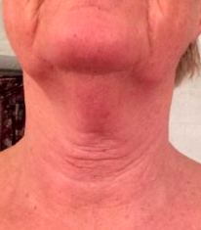
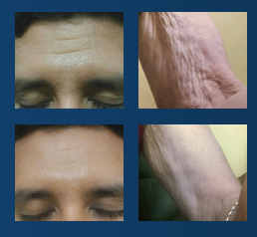
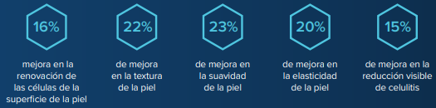
Notes:
Slide # 14 Renu 28 is a true cellular health product, based on breakthrough technology that can create amazing health benefits. It is a whole-body skin therapy allowing your body to heal one cell at a time. You can’t even compare it to products that are only for the face!

Slide 26
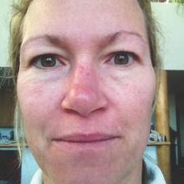
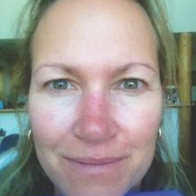
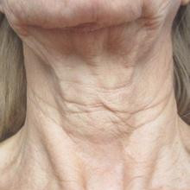
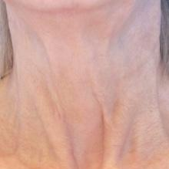
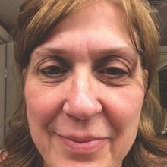
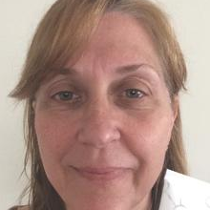
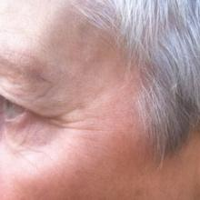
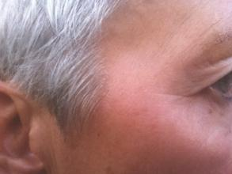
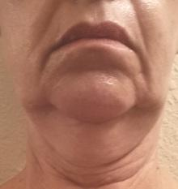
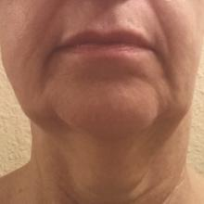
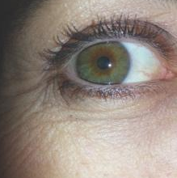
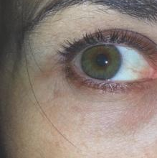
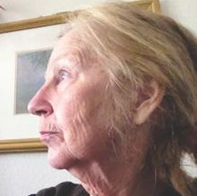
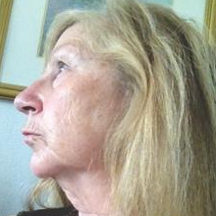
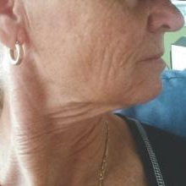
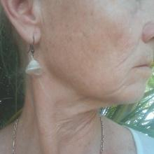
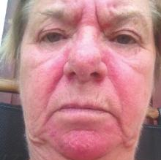















VER ES CREER!
Notes:
And I’m sure you’ve heard that seeing is believing. We can show you what this does on the outside of your body but we can’t show you pictures of your heart, lungs, liver…. Just imagine if it is making this big of a difference on the outside… what it could be doing on the inside?
Renu28 technology ( when applied to the skin) results in a healthy clear complexion, tighter, younger looking skin, while dramatically reducing wrinkles, stretch marks, cellulite and many other signs of aging. All while using the bodies own natural renewal and healing processes.

Slide 27

Notes:
Did you know 90% of women have cellulite and 10 % of men have it too? Not fair but that is life.
Renu 28 and our Advanced Skin care line is a whole body skin therapy. Dermatest did an independent clinical study on Cellulite and showed these changes in 12 weeks.

Slide 28



Slide 29


Slide 30


ACNE
Acné es la condición de salud de la piel mas común en las personas por todo el mundo.
Acné empieza normalmente en la pubertad y afecta a muchos adolescentes y adultos.
Este es el dia 1 y el dia 7 de Garret usando Renu 28.
Notes:
Acne is the most common skin condition in the United States, affecting up to 50 million Americans annually.1
Acne usually begins in puberty and affects many adolescents and young adults.
Approximately 85 percent of people between the ages of 12 and 24 experience at least minor acne.2
In 2013, the costs associated with the treatment and lost productivity among those who sought medical care for acne exceeded $1.2 billion.6
More than 5.1 million people sought medical treatment for acne in 2013, primarily children and young adults.

Slide 31


Slide 32

UNA EXTRAORDINARIA OPORTUNIDAD PARA TODO EL MUNDO
OPORTUNIDAD
Notes:
Slide # 19 The fact that ASEA is a network marketing company is fantastic because it provides people like you and me to be able to share these transformational products with others and earn “thank you” money. We are all here with different interests so lets go over a few options.
You may just want to cover the cost of your product, or supplement your household income.

Slide 33


Lunes
Miércoles
Viernes
Martes
Jueves
Sábado
Domingo

Slide 34

Lunes
Miércoles
Viernes
Martes
Jueves
Sábado
Domingo

Slide 35


Slide 36


Notes:
Current research shows that environmental factors such as stress, diet, the air we breathe, and aging can actually turn off genes, meaning the genetic instructions that dictate healthy body functions don’t get through.

Slide 37




Slide 38







43€
Notes:
It only takes $40 to start. And with the $40 you receive a starter kit with all the information you need to get started for success.
Then you pick a package of product that best fits your needs.

Slide 39


Estamos en el comienzo de algo GRANDE y con un gran propósito y justo hoy es el momento de comenzar a influir en el futuro…
PODEMOS CAMBIAR EL MUNDO.
Verdis Norton, fundador de ASEA
Notes:
Me gustaría concluir con unas palabras de nuestro fundador, Verdi Norton (léase cita).

Slide 42


